Slide 1
Stat 495r – Presenting Data
Week 3
Gestalt Principals

Slide 2
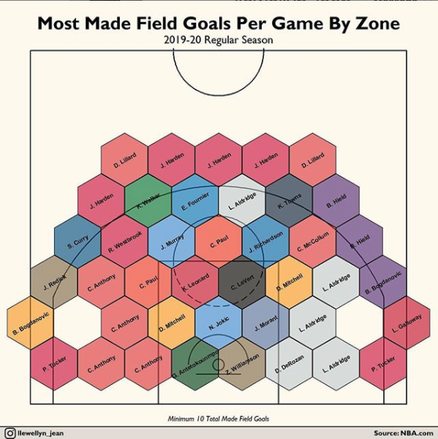
Data Viz #1

Slide 3
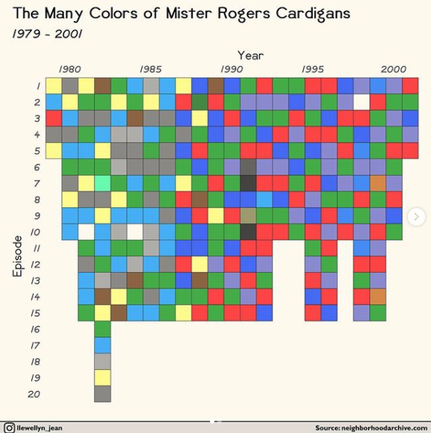
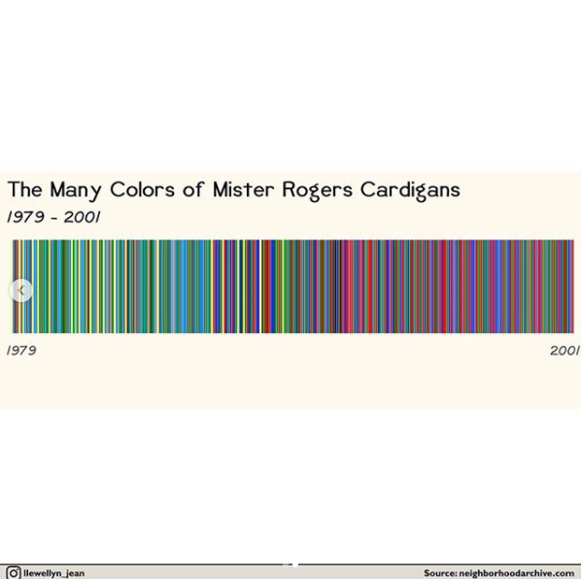
Data Viz #2

Slide 4
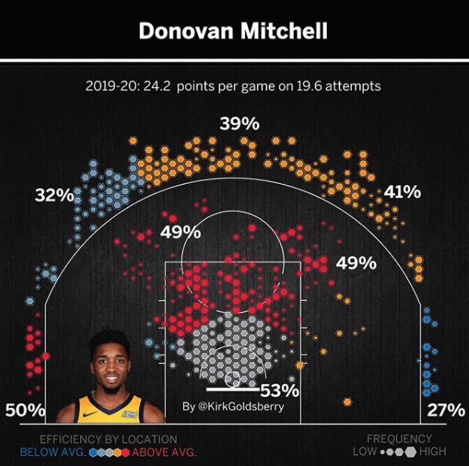
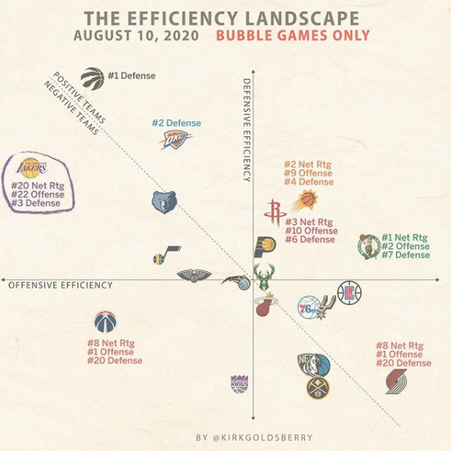
Data Viz #3

Slide 5
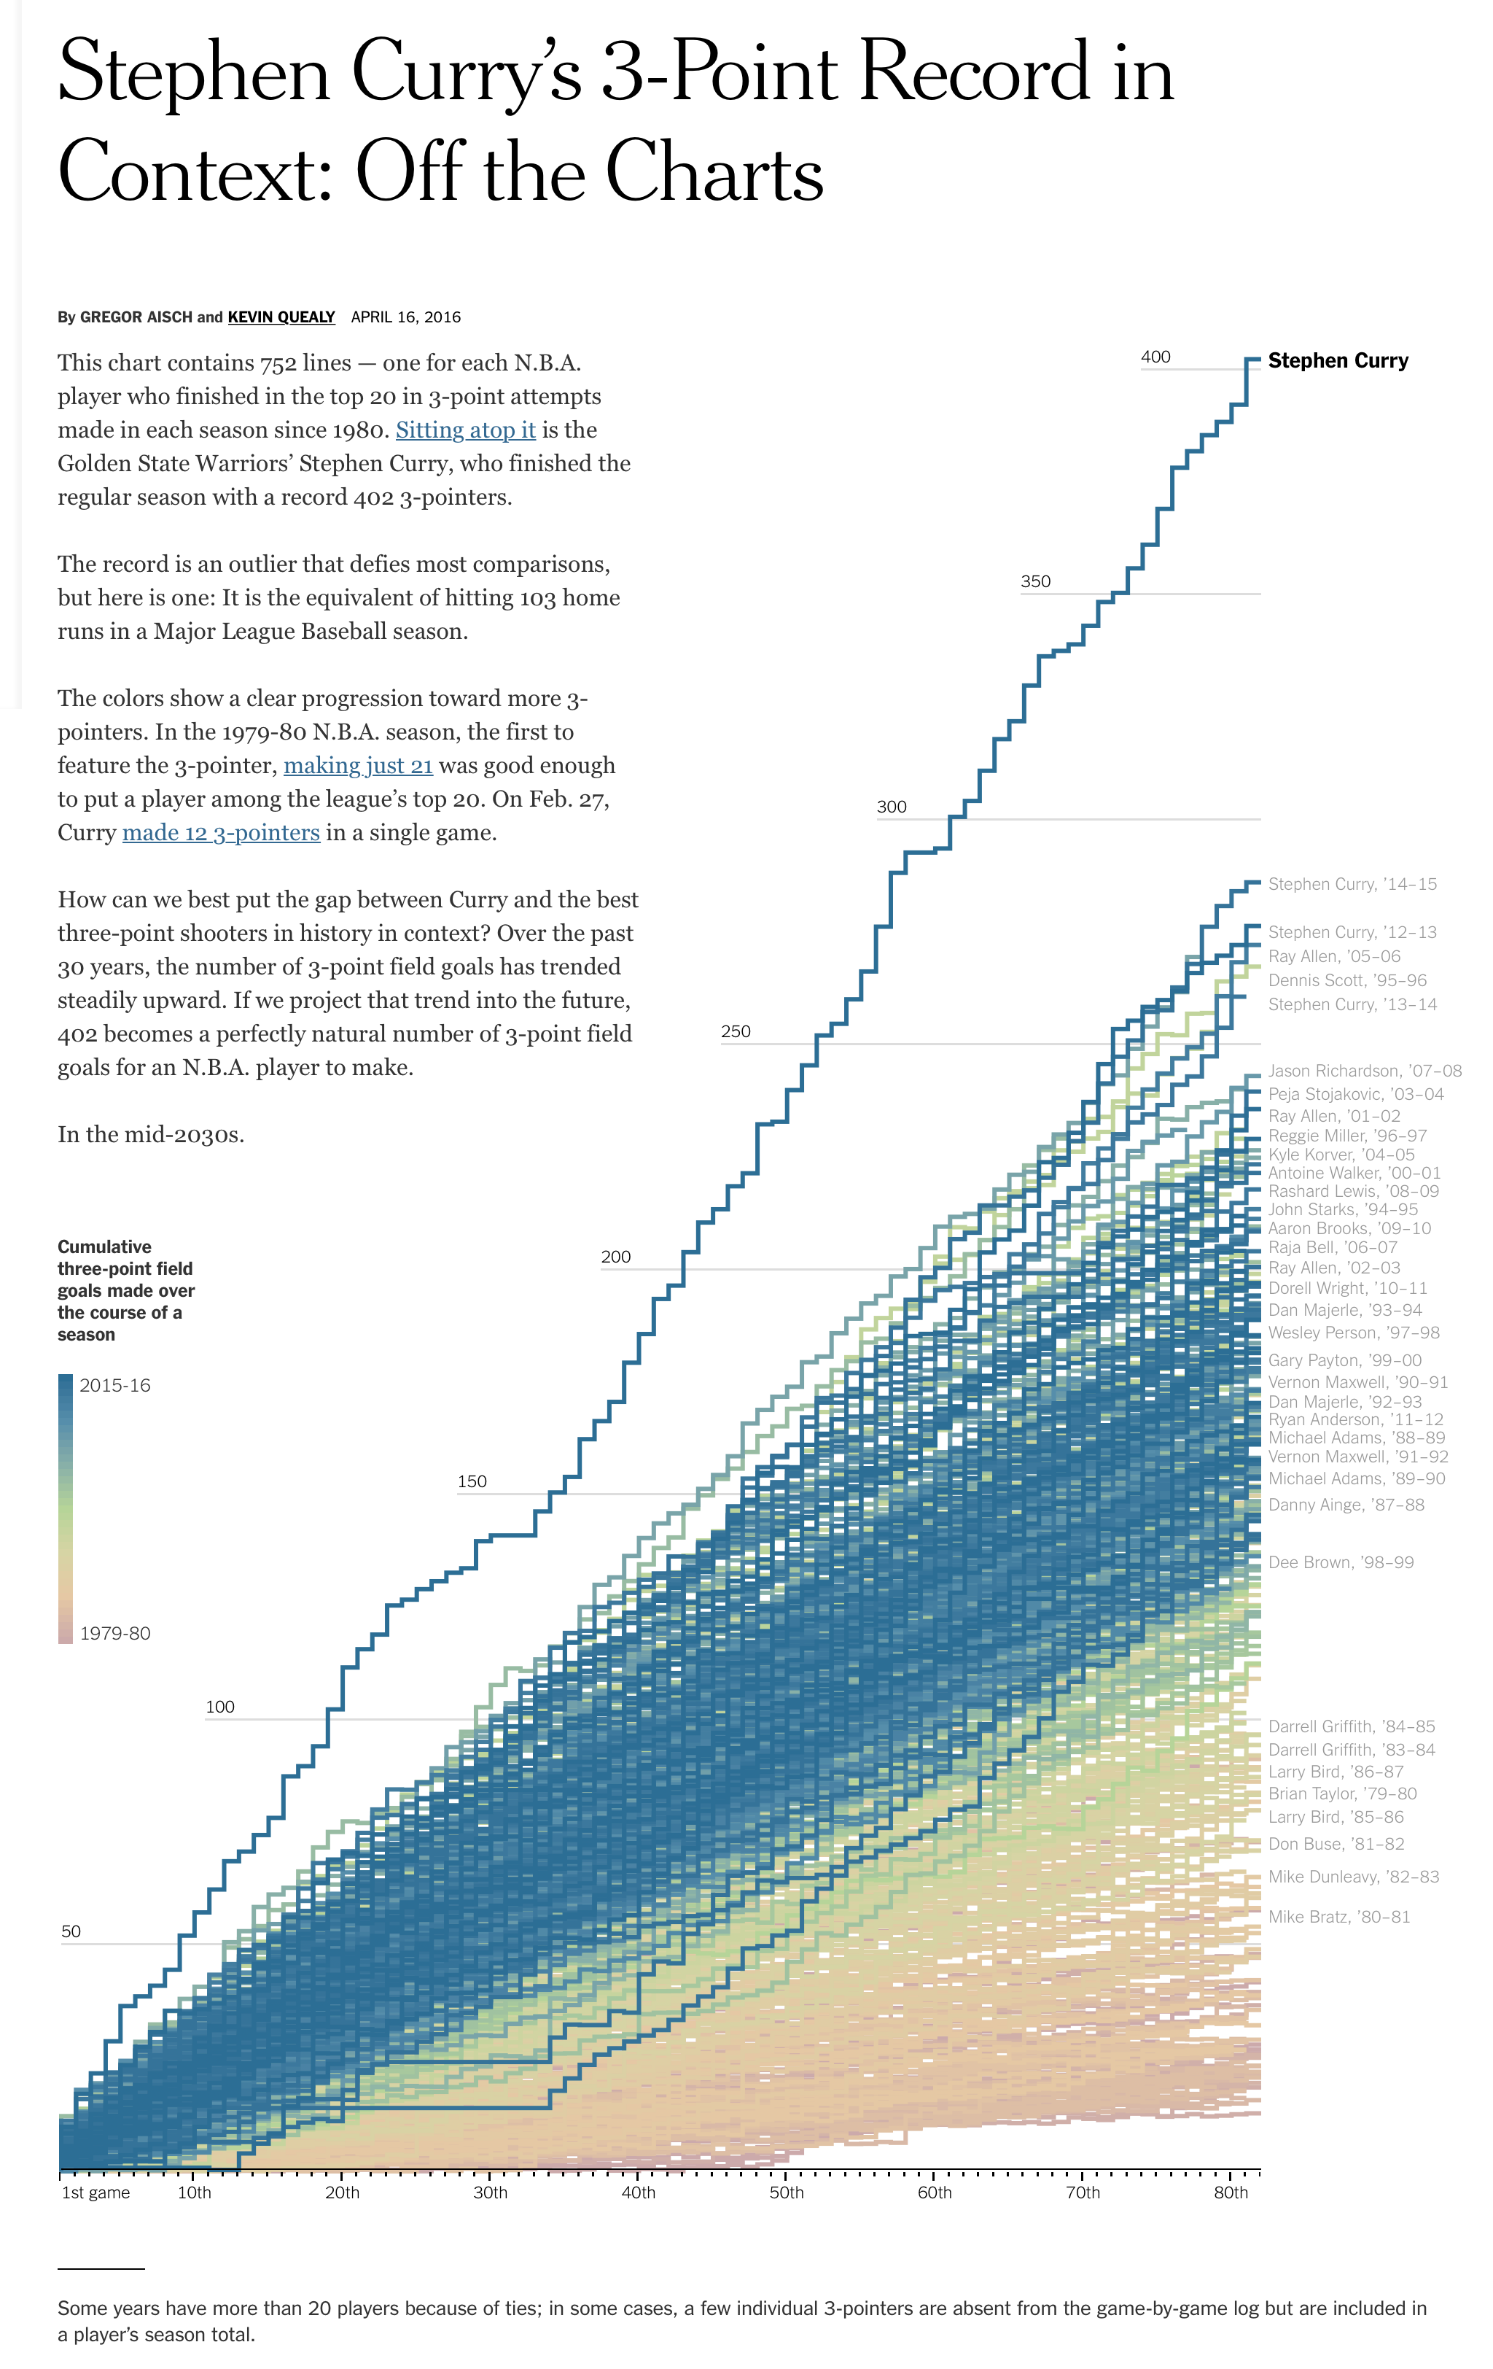
Data Viz #4

Slide 6
Book Club Time
Is it ok to have a non-zero baseline when graphing data?
How is the way that we process tables different from how we process graphs? What are the pros and cons to presenting data in tables versus graphs? In what circumstances does tables make sense? When should you avoid tables?
When graphing data, when should you include the y-axis label and when should it be omitted?
What is the purpose of graphing data in multiple ways? Why are iterations important?
Most graphs are bars and lines. When does it make sense to use the more familiar/novel types versus more “sexy?”
Are there examples of data that you have graphed in the past for other class that you wish you could redo now?
Have professors/peers/co-workers pushed you on how data has been historically graphed?
What are visualization design choices that you will be conscientious of in the future?

Slide 7
Homework #1 Questions

Slide 8
Homework #2 Questions

Slide 9
Elle-Rose had 2 standout quarters in Q3 and Q4 of 2019
Top 10 Sales Reps Quarters
Q4-2018 to Q4-2019

Slide 10
Homework 3 – Practice Making Visuals
Tier | # of Accounts | % Accounts | Revenue ($M) | % Revenue
A | 77 | 7.08% | $4.68 | 25%
A+ | 19 | 1.75% | $3.93 | 21%
B | 338 | 31.07% | $5.98 | 32%
C | 425 | 39.06% | $2.81 | 15%
D | 24 | 2.21% | $0.37 | 2%
1. Make at least 3 slides with visuals from this data that convey the story and information

Slide 11
Tier | # of Accounts | % Accounts | Revenue ($M) | % Revenue
A+ | 19 | 2% | $3.9 | 21%
A | 77 | 7% | $4.7 | 25%
B | 338 | 31% | $6.0 | 32%
C | 425 | 39% | $2.8 | 15%
D | 24 | 2% | $0.4 | 2%
All other | 205 | 19% | $0.9 | 5%
TOTAL | 1,088 | 100% | $18.7 | 100%
Notes:
A and A+ make up a small percent of % accounts but a high percent of % revenue
A total row is nice – did you notice some accounts were missing?
Remove a digit since it’s not significant/meaningful detail

Slide 12
Tier | ACCOUNTS |  | REVENUE
 | # | % OF TOT | $M | % OF TOT
A+ | 19 | 2% | $3.9 | 21%
A | 77 | 7% | $4.7 | 25%
B | 338 | 31% | $6.0 | 32%
C | 425 | 39% | $2.8 | 15%
D | 24 | 2% | $0.4 | 2%
All other | 205 | 19% | $0.9 | 5%
TOTAL | 1088 | 100% | $18.7 | 100%
Notes:
Remove shading – it doesn’t help
Avoid center alignment for jagged edges on both sides (right align by decimal point)
Removing redundancy in columns and make more narrow
Let your eye zigzag “Z” – Most important at the top left. Move revenue columns left?
Where are eyes drawn – titles not the data. Use colors to draw eyes to data

Slide 13
Tier | ACCOUNTS |  | REVENUE
 | # | % OF TOT | $M | % OF TOT
A+ | 19 | 2% | $3.9 | 21%
A | 77 | 7% | $4.7 | 25%
B | 338 | 31% | $6.0 | 32%
C | 425 | 39% | $2.8 | 15%
D | 24 | 2% | $0.4 | 2%
All other | 205 | 19% | $0.9 | 5%
TOTAL | 1088 | 100% | $18.7 | 100%
Notes:
1. Replace heatmap with horizontal bars. Draws attention to disparity between % accounts and % revenue

Slide 14
New client tier share
% of Total Accounts
% of Total Revenue

Slide 15
New client tier share
TIER | % OF TOTAL ACCOUNTS | % OF REVENUE

Slide 16
New client tier share
TIER | % OF TOTAL ACCOUNTS vs. REVENUE

Slide 17
New client tier share
% OF TOTAL ACCOUNTS vs. REVENUE
TIER

Slide 18
New client tier share
% OF TOTAL ACCOUNTS vs. REVENUE
TIER

Slide 19
New client tier share
% OF TOTAL ACCOUNTS vs. REVENUE
TIER

Slide 20
New client tier share
% OF TOTAL ACCOUNTS vs. REVENUE
TIER
B
A
A+
C
All others
D
% OF TOTAL ACCOUNTS
% OF TOTAL REVENUE

Slide 21
New client tier share
CUM % OF TOTAL REVENUE vs. ACCOUNTS
TIER

Slide 22
New client tier share
Revenue Per Account
TIER

Slide 23
New client tier share
CUM % OF TOTAL ACCOUNTS vs. REVENUE
Difference between CUM REV and CUM # OF ACOUNTS
TIER

Slide 24
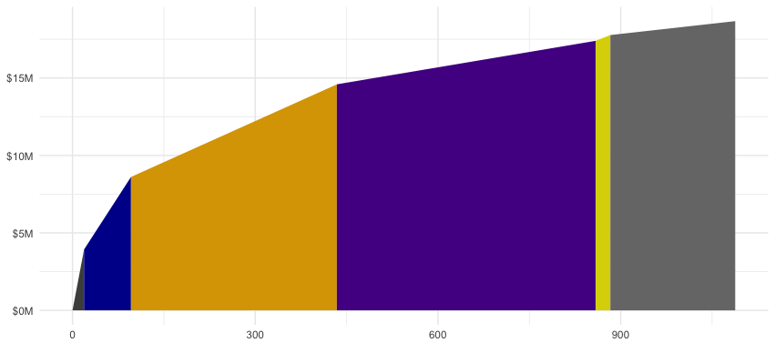
New client tier share
CUM REVENUE
TIER
A+
A
B
C
All others
CUM ACCOUNTS

Slide 25

New client tier share
CUM % REVENUE
TIER
A+
A
B
C
All others
CUM % ACCOUNTS

Slide 26

New client tier share
$6.0
$4.7
$3.9
REVENUE ($M)
$2.8
$0.4
A
B
C
All others
$0.9
19
77
338
425
205
A
TIER
A+
B
C
D
All others
# ACCOUNTS

Slide 27

New client tier share
425
338
# ACCOUNTS
205
77
All Others
A+
A
B
C
19
$4.7
$6.0
$2.8
$0.9
$3.9
REVENUE ($M)
D

Slide 28
Bar Charts

Slide 29
Vertical bars are good for continuous data and negative y-values; horizontal bars are good for long x-value names, but bad for negative values
Education
Manufacturing and Forestry
Advertising and Creative

Slide 30


Use horizontal labels, diagonal work in a pinch

Slide 31
Space bars at 50% or 66% the bar width
This is PowerPoint/Excels default width

Slide 32
Use consistent colors

Slide 33
Bar Chart Theory
Advertising and Creative
Education
Education
Manufacturing and Forestry
Manufacturing and Forestry
Advertising and Creative
PowerPoint, Excel and ggplot2 all order ascending so reverse the axis in the options

Slide 34
Start the y-axis at 0
PowerPoint/Excels default to random starts

Slide 35
Use arrows to note if the bars extend off the chart

Slide 36
Show broken bars when the y-axis minimum is not 0

Slide 37
Pie Charts

Slide 38

Pie Charts

Slide 39
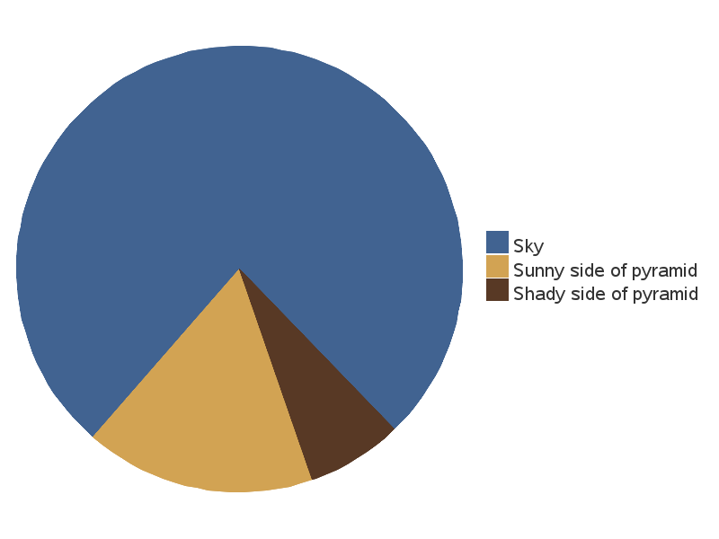

Slide 40
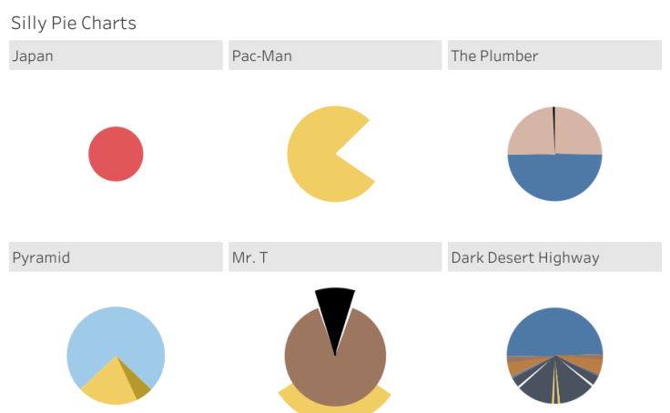

Slide 41
Pies are common and show the PART-TO-WHOLE relationship, but lack precision – use with few categories and when accuracy isn’t important
19%
Purchase with Add-on
Stylize with text and icons
Notes:
We are only really good at gauging size of familiar percentages (25%, 50%, etc.) – Stephen Few
Donut chart encoding is length not angle size

Slide 42
Order slices clockwise starting at 12 o’clock largest to smallest or most important to least important
Exception first slice angle is using in a combo

Slide 43
Make sure all data adds up to 100%
Tip: Always have the data labels be the “value” not the ”percent”
Notes:
Is

Slide 44
Visualize no more than 5 categories
Tip: Group small categories
Notes:
Is

Slide 45
Don’t use multiple pie charts for comparison
Tip: Draw in lines between categories

Slide 46

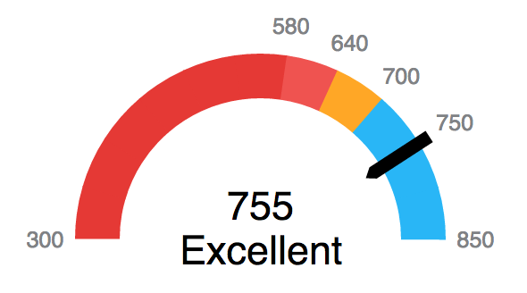
Use Harvey Balls for icons; make art by using polar coordinates; use gauges sparingly
Notes:
Color art forthcoming

Slide 47
First slice angle exception is when using pies to support another, more important graph; exploding the slice for emphasis sparingly

Slide 48
Line Charts

Slide 49
Include a zero baseline if possible

Slide 50
Use the right height

Slide 51
Don’t plot more than 4 lines

Slide 52
If using data markers, be bold

Slide 53
Use solid lines only – no dots, dashes or patterns

Slide 54
Label on the line (before, during or after), not in a legend
Dave
Aaron
Stan
Everyone Else

Slide 55
Scatter Plots

Slide 56
Center on the important data

Slide 57
Use trendlines, but not more than 1

Slide 58
Encode more variables – but not too many
Saab
20
Volvo
10
5
AMG
Best just not to do this in PowerPoint/Excel – use ggplot2
Notes:
Don’t use odd shapes, make sure labels are visible

Slide 59
Tables

Slide 60
Use colors lightly
Tier | # of Accounts | % Accounts
A+ | 77 | 7%
A | 19 | 1%
B | 338 | 31.%
C | 425 | 39%
D | 24 | 2%
Tier | # of Accounts | % Accounts
A+ | 77 | 7%
A | 19 | 1%
B | 338 | 31.%
C | 425 | 39%
D | 24 | 2%

Slide 61
Be mindful of text alignments
Tier | # of Accounts | % Accounts
A+ | 77 | 7%
A | 19 | 1%
B | 338 | 31.%
C | 425 | 39%
D | 24 | 2%
Tier | # of Accounts | % Accounts
A+ | 77 | 7%
A | 19 | 1%
B | 338 | 31.%
C | 425 | 39%
D | 24 | 2%

Slide 62
Be mindful of borders
Tier | # of Accounts | % Accounts
A+ | 77 | 7%
A | 19 | 1%
B | 338 | 31.%
C | 425 | 39%
D | 24 | 2%
Tier | # of Accounts | % Accounts
A+ | 77 | 7%
A | 19 | 1%
B | 338 | 31.%
C | 425 | 39%
D | 24 | 2%

Slide 63
Add total rows and avoid too many rows
Tier | # of Accounts | % Accounts
A+ | 77 | 7%
A | 19 | 1%
B | 338 | 31.%
C | 425 | 39%
D | 24 | 2%
E | 12 | 1%
F | 10 | 1%
G | 5 | 1%
H | 2 | 1%
I | 5 | 1%
Tier | # of Accounts | % Accounts
A+ | 77 | 7%
A | 19 | 1%
B | 338 | 31.%
C | 425 | 39%
D | 24 | 2%
TOTAL | 883 | 100%

Slide 64
Text

Slide 65
Wordsmith to be concise and clear
We make sticky clients
10%
higher return rate
Clients that used our team are 10% more likely to return for another project in the next to quarters

Slide 66
Use color and size for effect – but don’t overdo it
10%
higher return rate over the next 2 quarters
60% of clients for our team returned vs 50%
for other teams

Slide 67
Gestalt Principals

Slide 68
Activity

Slide 69
Draw it first!
The next slide will include a data set
Take 10 solid minutes and draw several ways to visualize the data
This is not an art class (sorta) so let your pencil move as fast as your mind can
Then pick your favorite and refine it
Use PowerPoint to recreate your visual

Slide 70
Draw it first!
The next slide will include a data set
Take 10 solid minutes and draw several ways to visualize the data
This is not an art class (sorta) so let your pencil move as fast as your mind can
Then pick your favorite and refine it
Use PowerPoint to recreate your visual
Average time to close deal (days)
Product | Direct Sales | Indirect Sales | Total Sales
A | 83 | 145 | 128
B | 54 | 131 | 127
C | 89 | 122 | 107
D | 90 | 129 | 118

Slide 71
Homework

Slide 72
Homework #1
Read this article: https://www.deseret.com/indepth/2020/9/11/21430729/utah-utes-furlough-whittingham-krystkowiak-ncaa-football-coronavirus-college-sports-covid
Create a data visualization that could be used in the article to help the story. Feel free to use alternate data sources. A couple good ones include:
https://transparent.utah.gov/emp.php
https://utahutes.com/sports/2016/6/10/school-bio-budget-fiscal-year-2016-html.aspx

Slide 73
Homework #2 – Improve this visual
Top 19 Reps Ranked by their Sales Each Quarter
With the number of ”Bonus Point” projects sold
Rank | Q4 - 2018 | Q1 - 2019 | Q2 - 2019 | Q3 - 2019
1 | Zubair Terry - 7 | Rhia Montgomery - 1 | Robert Kirkpatrick - 0 | Janae Foley - 1
2 | Alysia Hogan - 1 | Kenzo Yates - 0 | Zubair Terry - 6 | Zubair Terry - 18
3 | Kenzo Yates - 5 | Zubair Terry - 6 | Darcey Olson - 0 | Colm Watts - 2
4 | Kaiya Gonzalez - 0 | Colm Watts - 1 | Colm Watts - 2 | Ansh Mack - 1
5 | Colm Watts - 4 | Annabelle Carroll - 2 | Kenzo Yates - 2 | Alysia Hogan - 0
6 | Alina Bishop - 1 | Ansh Mack - 0 | Nora Lutz - 0 | Fox Coleman - 4
7 | Fox Coleman - 0 | Fox Coleman - 7 | Aayan Greer - 3 | Aayan Greer - 1
8 | Nora Lutz - 0 | Aayan Greer - 1 | Taylan Archer - 1 | Kenzo Yates - 2
9 | Aayan Greer - 0 | Kaiya Gonzalez - 1 | Ailish Maguire - 0 | Faheem Lam - 0
10 | Robert Kirkpatrick - 0 | Taylan Archer - 1 | Alysia Hogan - 0 | Taylan Archer - 4
11 | Steffan Mann - 3 | Cohan Meza - 0 | Annabelle Carroll - 2 | Annabelle Carroll - 3
12 | Janae Foley - 2 | Faheem Lam - 0 | Kaiya Gonzalez - 0 | Cohan Meza - 2
13 | Faheem Lam - 1 | Cherise Quintero - 1 | Alina Bishop - 0 | Janae Foley - 1
14 | Annabelle Carroll - 3 | Ailish Maguire - 0 | Faheem Lam - 0 | Gareth Lamb - 3
15 | Darcey Olson - 1 | Petra Juarez - 1 | Chenai Stubbs - 2 | Cherise Quintero - 0
16 | Cherise Quintero - 1 | Alysia Hogan - 0 | Cherise Quintero - 5 | Eben Briggs - 1
17 | Taylan Archer - 4 | Janae Foley - 0 | Cohan Meza - 2 | Abdallah Reed - 4
18 | Sultan Baldwin - 1 | Abdallah Reed - 0 | Petra Juarez - 0 | Kaiya Gonzalez - 0
19 | Cohan Meza - 0 | Chenai Stubbs - 2 | Greg Knowles - 5 | Nora Lutz - 2

Slide 74
Homework #3
President Trump recently spoke with California’s Governor Newsom regarding the wildfires. Newsom said climate change exasperated the wildfires. Trump said disagreed and pointed to poor forestry management. Which is it?
You are working as an intern for a Utah senator who is considering both climate change and forestry management legislation, but both topics are lower priority to him. He wants to be better informed on the topic and asks you to look into it. He is expecting a 10 minute in-person briefing, but you know from experience that his schedule is crazy and that is likely to cancel – you may only get to send your presentation and hope he looks at it.
Attached is a data set that includes the wildfires (over 300 acres) in California. Feel free to find other data sources as well.
Create a ~3 slide deck that answers the following questions:
What is the magnitude of wildfire growth?
What specifically has been causing wildfires/destruction in the past years?
Is climate change responsible for the increase in wildfires/destruction?
Considerations
Is this the best data set to use?
What other data might be useful?

